Slide 1
Semantic Retrieval of ICS Security Requirements from BSI and NIST Standards
Dipan Banerjee
Notes:
1

Slide 2
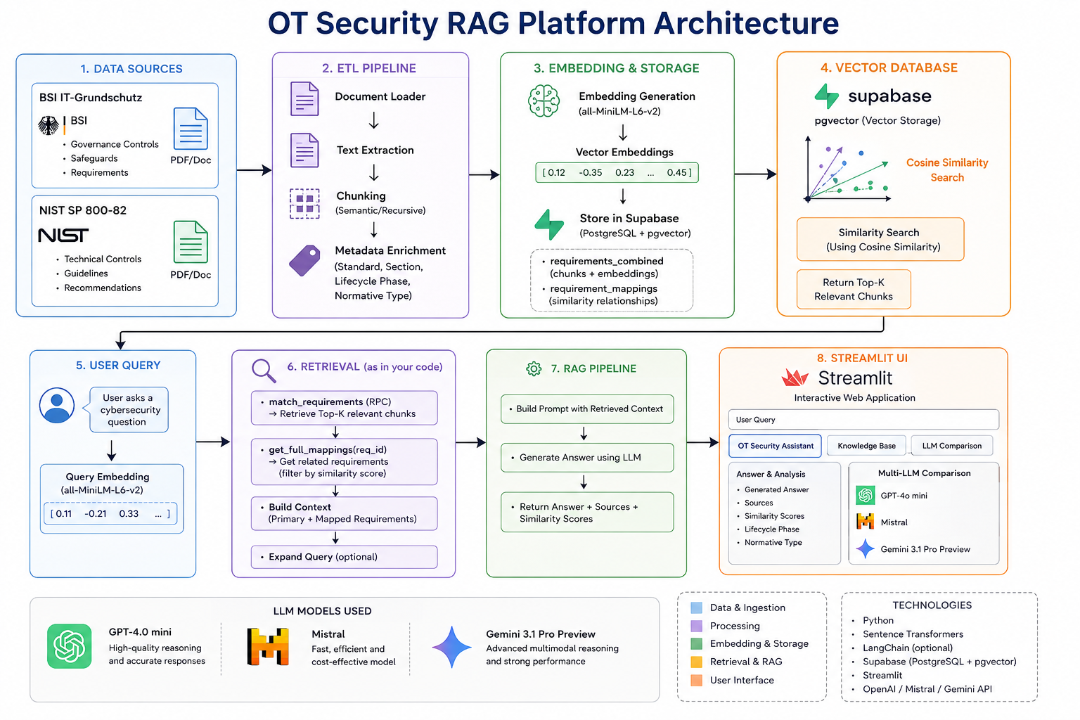
Recap
2
Notes:
2

Slide 3
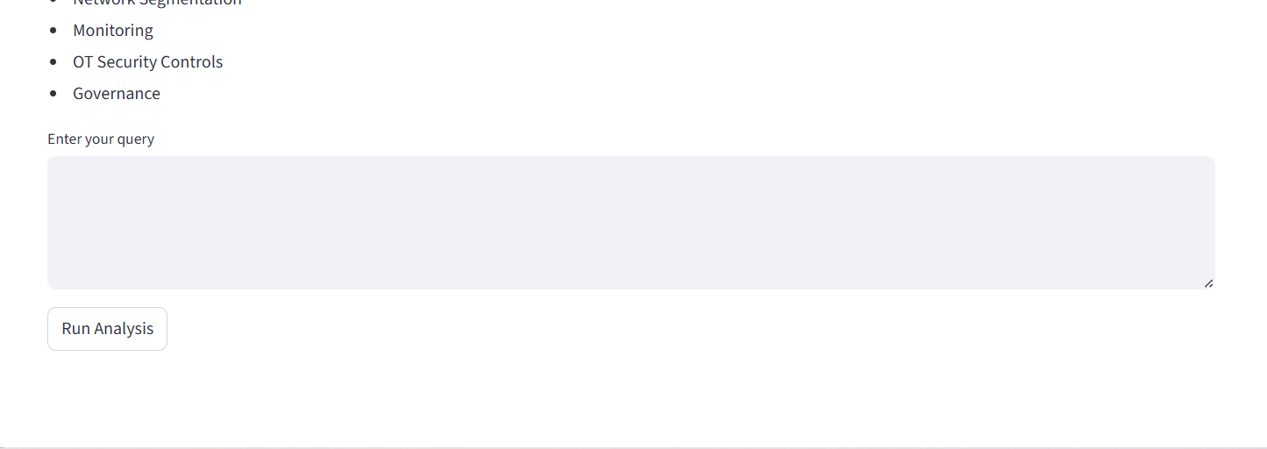
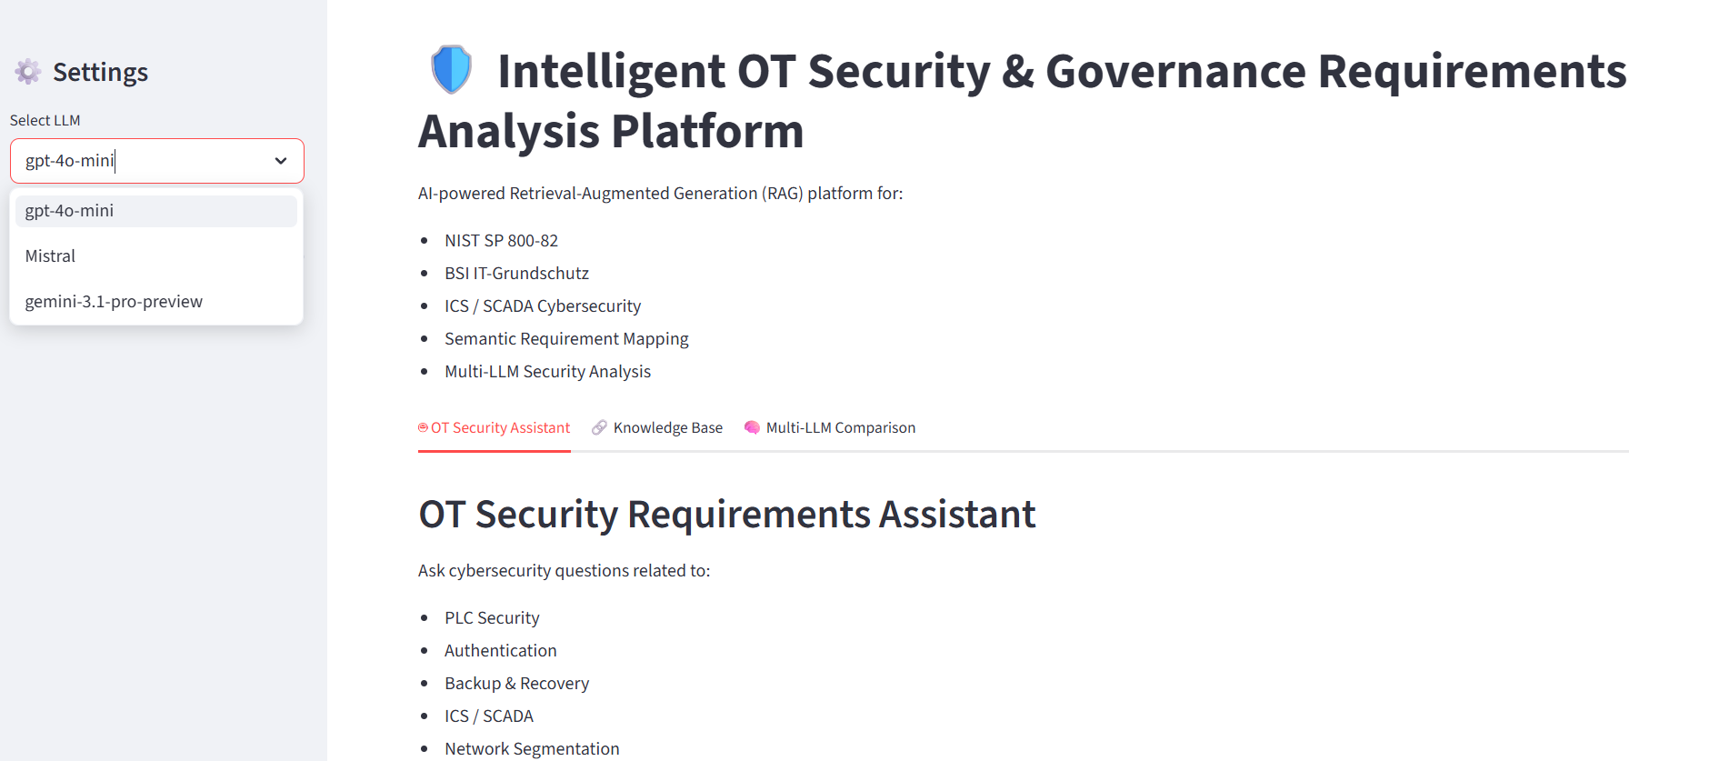
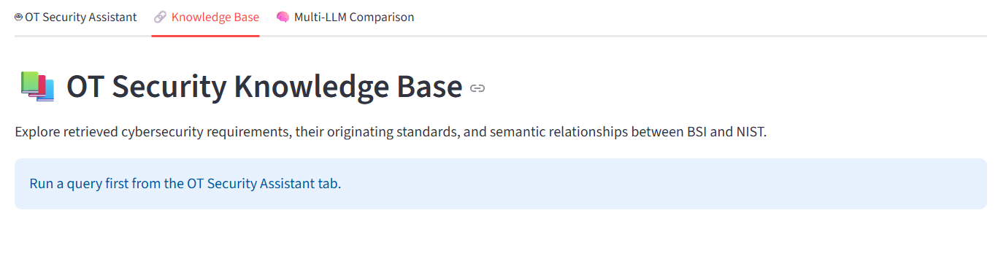
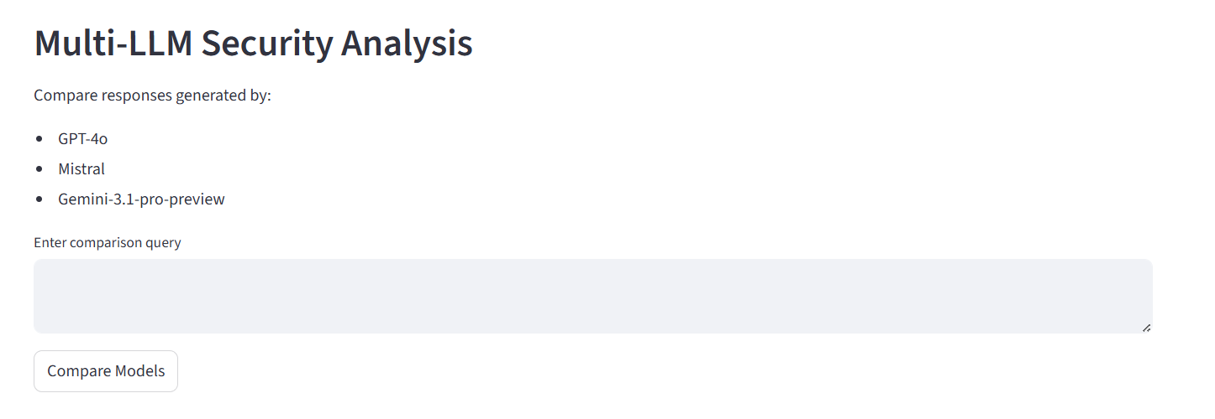
Reap - Streamlit App
3
Notes:
3

Slide 4
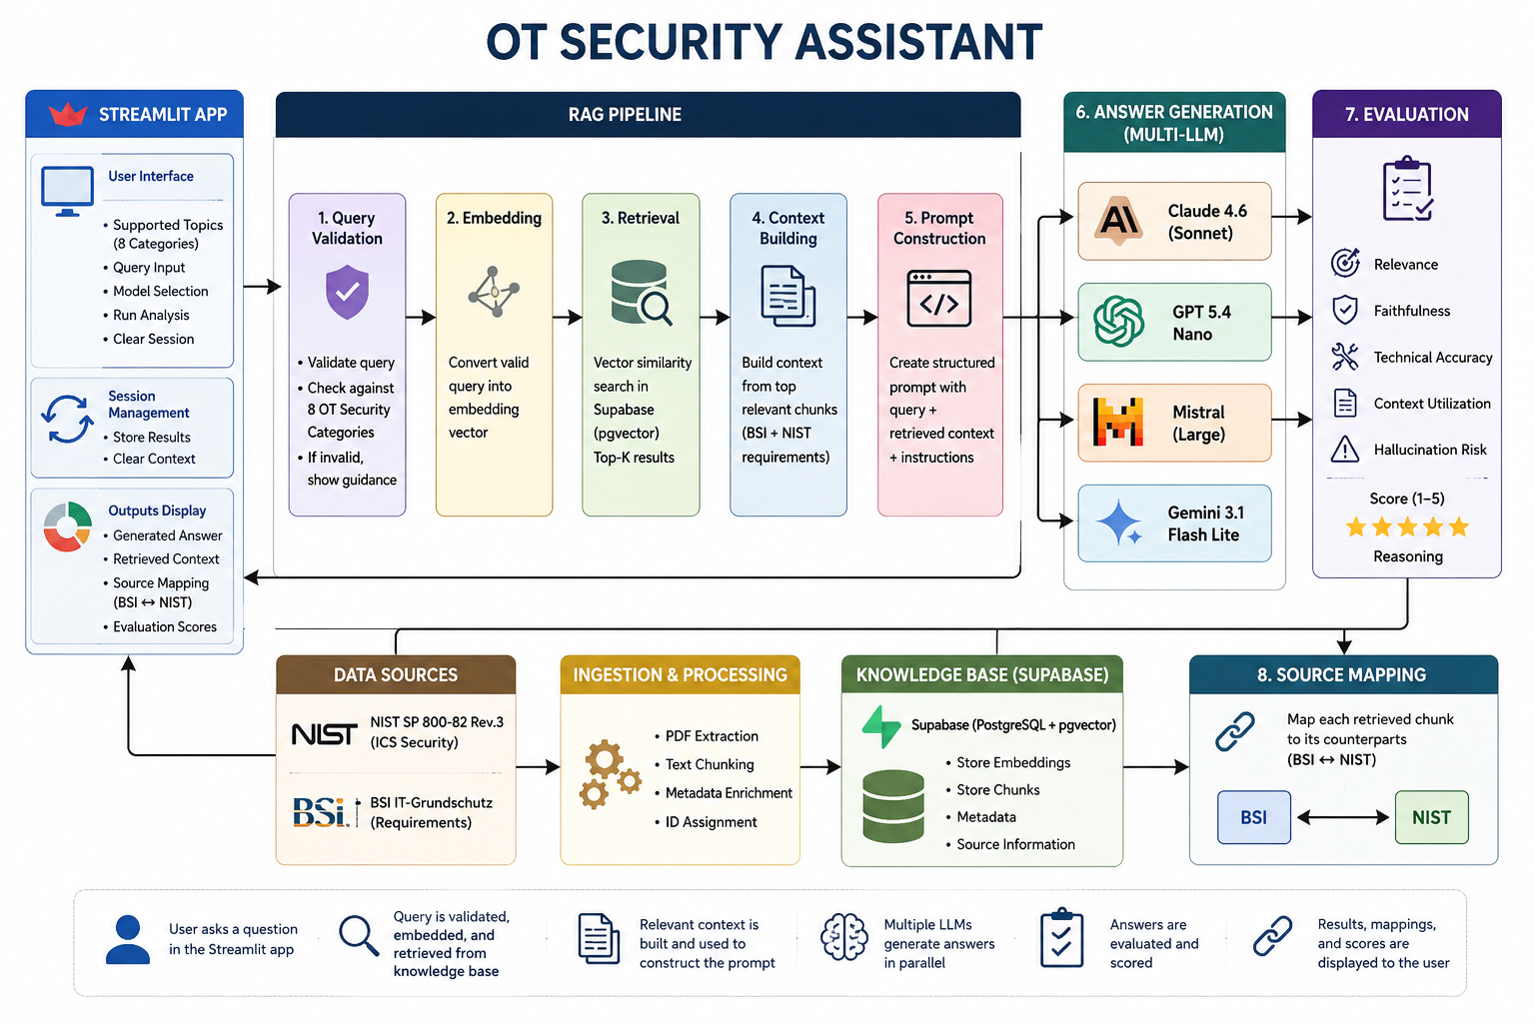
Improved Architecture
4
Notes:
4

Slide 5
Improvements
5
Improved the design of the app.
Extracted chunks with 100 words to increase the knowledge base details.
Introduced claude and eliminated gpt 4.0 mini.
Adjusted the wrong input by using retrieval query similarity score.
Introduced RAGAS(LLM as a judge) which shows technical accuracy, hallucination, semantic context. [1]
Emperical studies shown the gpt 4 onwards, LLM evaluation is 80% similar to human evaluation.[2]
Notes:
5

Slide 6
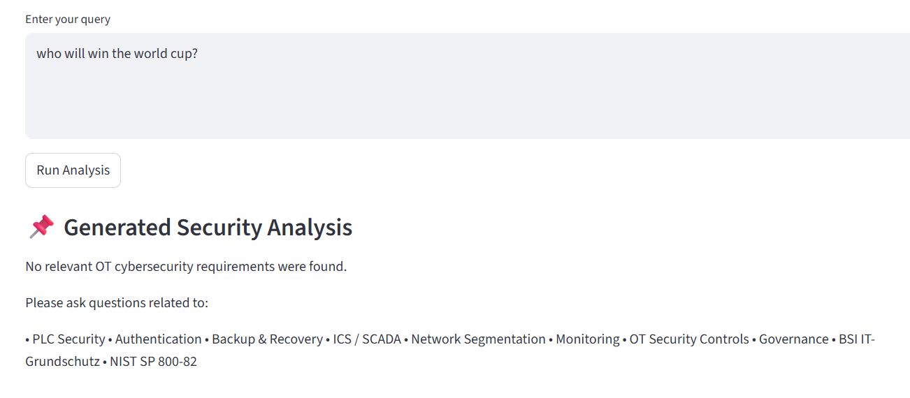
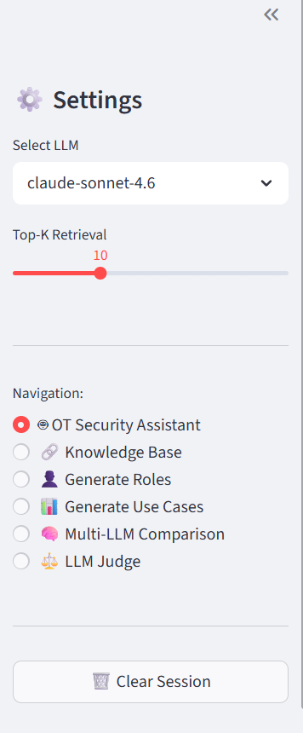
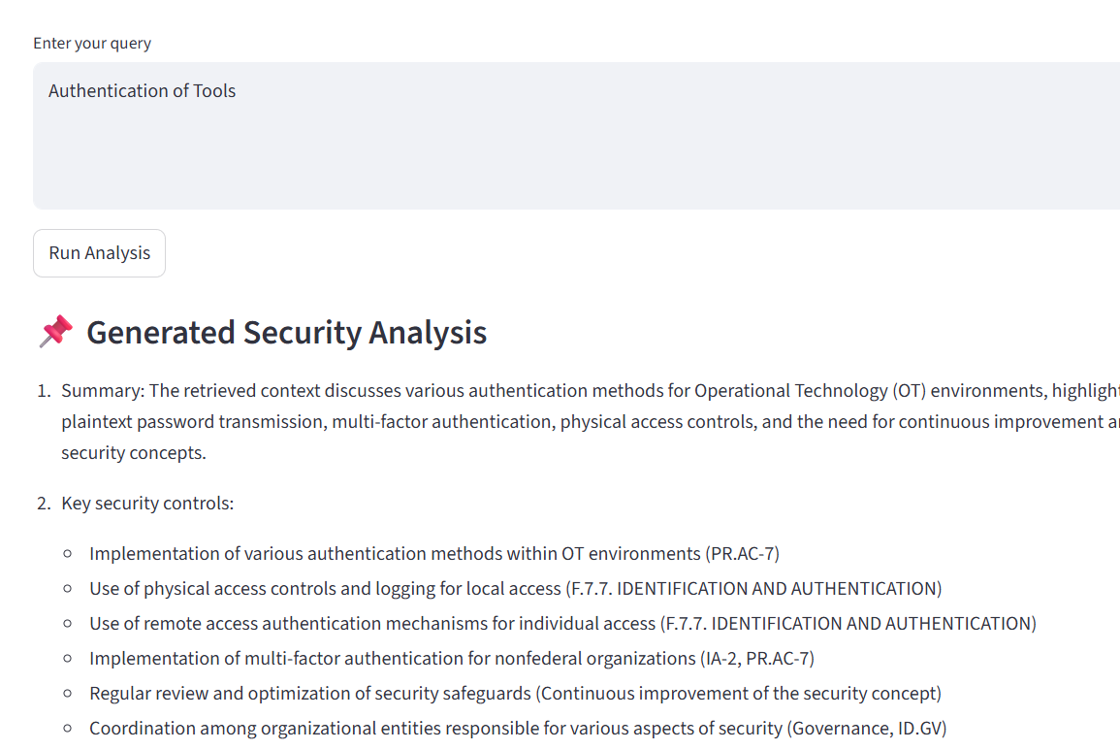
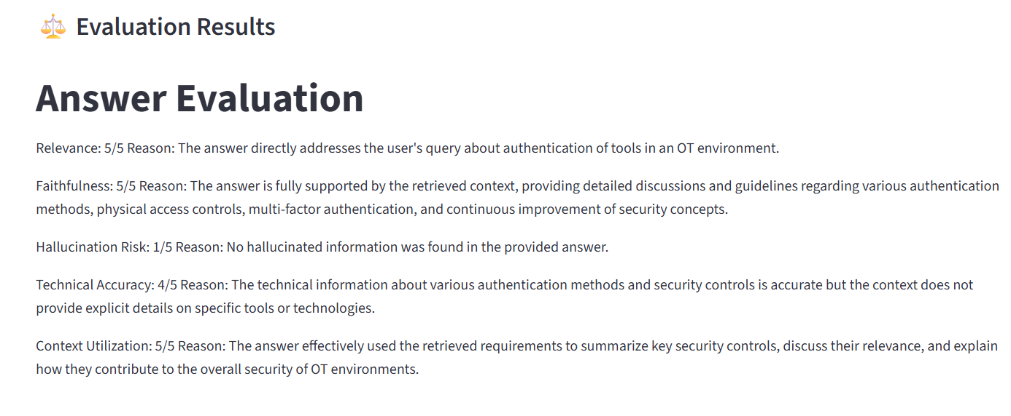
Improvements
6
Notes:
6

Slide 7
Task for Human Evaluation
Students will be divided into 2 groups with their categories.
Each student will run 2-3 queries. Total 80 queries per group.
They will run the analysis on the app and look at the relevance. Mark score out of 5(1 is not relevant, 5 most relevant)
Check the knowledge base and look at the small chunks with the title and also mention whether matches or not and how many matches.. Also check the similarity between NIST and BSI and give relevance score.
Students will also say which LLM model gives better answer and rank them accordingly or choose the best.
It will take not more than 40 minutes per student.
Everything will be mentioned in the google form and then feedback for the development and also how can this app can help organizations.

Slide 8
Topics of Discussion
8
ARES is also important. Can it be introduced in the backend?
Can Vectorless Rag using PageIndex be introduced in this, if so how to incorporate in the app?
Notes:
8

Slide 9
References
9
Hämäläinen, A., 2025. Improving Retrieval-Augmented Generation with LLM-as-a-Judge Evaluation.
L. Zheng, W.-L. Chiang, Y. Sheng, S. Zhuang, Z. Wu, Y. Zhuang, Z. Lin, Z. Li, D. Li, E. Xing, H. Zhang, J. E. Gonzalez, and I. Stoica, “Judging LLM as-a-Judge with MT-Bench and Chatbot Arena,” in Thirty-seventh Conference on Neural Information Processing Systems Datasets and Benchmarks Track, 2023. [Online]. Available: https://openreview.net/forum?id=uccHPGDlao
Notes:
9

Slide 10
10
Thank you
Notes:
10

